Slide 1
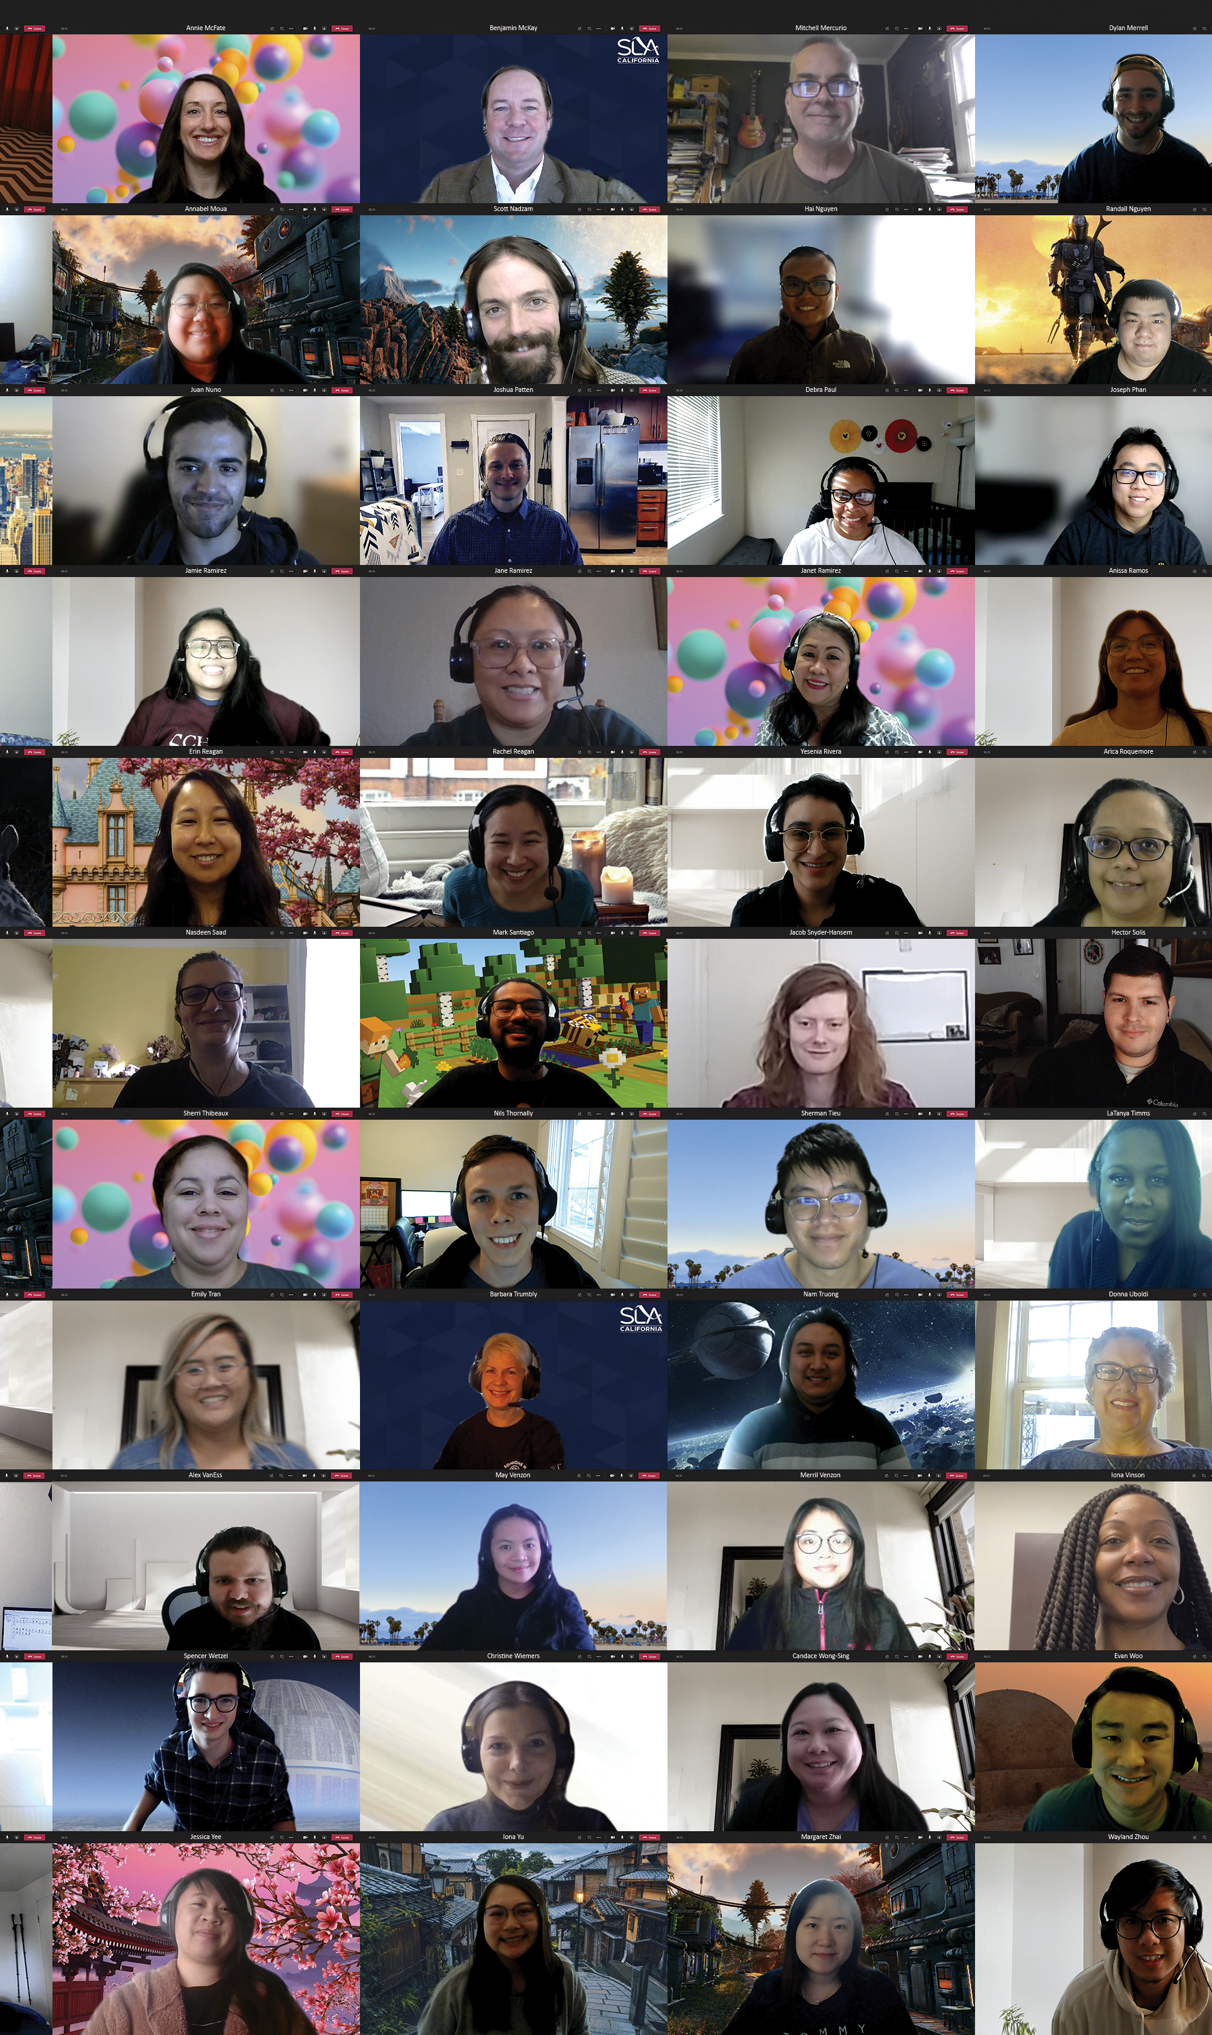
Diversity Equity Inclusion
Diversity is understanding that everyone is unique and recognizing our individual differences.
Inclusion prompts answers about creating environments conducive to feedback, supporting diversity, and being open.
Equity is fairness, sameness, and valuing diversity and inclusion.

Slide 2
Diversity
Race, gender, sexual orientation, religion, socioeconomic background, hobbies & interests are examples of diversity.
The labels we attach to people will influence how both we and others see them.
Stereotypes influence what we encode, what we notice, and what we remember.
We end up seeing what we expect to see.

Slide 3
Equity
Equity recognizes that each person has different circumstances and allocates the exact resources and opportunities needed to reach an equal outcome.
Equality means things are “the same” and equity means things are “fair.”

Slide 4
Inclusion
The achievement of a work environment in which all individuals are treated fairly and respectfully, have equal access to opportunities and resources, and can contribute fully to the organization's success
Seven Pillars of Inclusion:
Access
Attitude
Choice
Partnerships
Communication
Policy
Opportunities

Slide 5
Diversity within the SLA
Diversity is being invited to the party; inclusion is being asked to dance.
~ Verna Myers

Slide 6
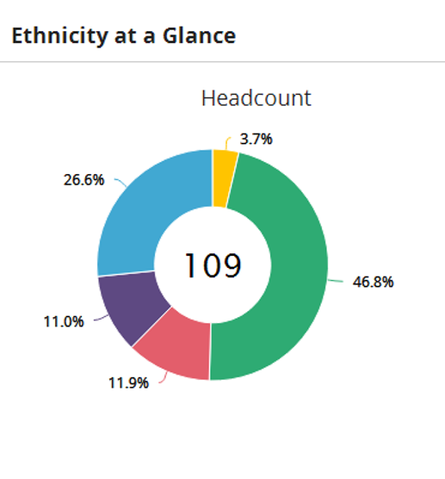
Key Diversity Metrics
46.8% Asian
26.6% White
11.98% Two or more races
11.06% Black
3.7% Hispanic

Slide 7
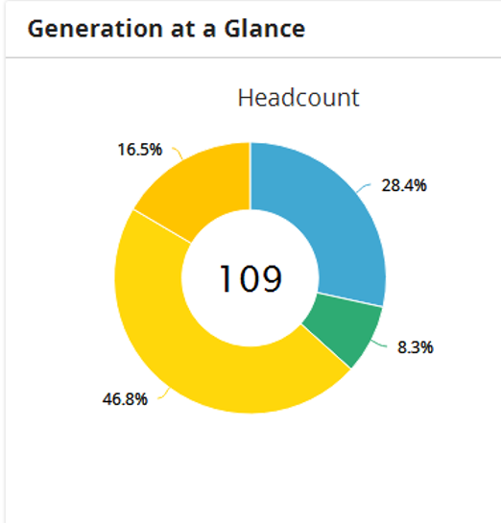
Key Diversity Metrics
46.8% Millennials
28.4% Generation X
16.5% Generation Z
8.3% Baby Boomers

Slide 8
SLA Models DEI Initiatives
Hiring, job descriptions, wages and promotions are scrutinized for diversity, fairness, and inclusiveness.
Educational opportunities are available to all team members.
Educational assistance is available to all team member’s children.
Ethnic holidays are celebrated with all staff.
Surveys are used to collect feedback on culture.
Badge for achievements are given through Paylocity.

Slide 9
Professional Development
Senior Management Training
Tools for Management
Management Techniques
Diversity, Equity & Inclusion
Wellness Counseling
SLA Team Training
ASLI
Financial Fundamentals
Digital Technical Training
LearnIt
Sexual Harassment
Technology Training
Project Management
Ergonomic Training
Wellness Cohorts

Slide 10
Sharing Our Vision
An uncompromising and consistent inclusive vision and encourage others to take the same stance by modeling and messaging the behavior.
Make sure our members and key stakeholders understand that we have high standards.
Hold ourselves and board members accountable. Act as a resource for key stakeholders.
Make it the norm for people to consider possible inclusion consequences before making any decision or taking any action.
Showcase the diversity of our staff through media communications

Slide 11
How can you help further the SLA DEI Initiatives?
Make
1
Make DEI part of your management discussion.
Take
2
Take training on creating a diverse and inclusive environment.
Create
3
Create a DEI cohort, or join one.
Check
4
Check your stereotypes at the door
Watch
5
Watch the use of labels
Embrace
6
Embrace change

Slide 12
Next Steps
Special Advisory to discuss and implement DEI initiatives.
SLA team cohorts organized to discuss DEI initiatives.
Annual Meeting speaker on DEI
Board and Committee members will be selected with an eye on deliberate diversity and inclusion metrics.

